Slide 1
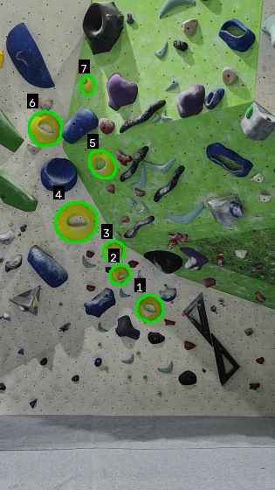
SendIt
FINAL YEAR PROJECT · CSIS 2026–27
A bouldering tracker that spots your route, watches the climb and logs the outcome for you
Kevin Monahan · Computer Systems
Supervisor: Fazilat Hojaji
Notes:
Hi, I’m Kevin. My project is SendIt, a mobile app for bouldering. You set your phone on a tripod, it finds the route you’re about to climb, watches the attempt and logs whether you topped it or fell, without you touching the phone. The image is real output from my prototype: the lime route at Suas, with every lime hold found automatically.

Slide 2
The problem: logging climbs is manual
MOTIVATION
Time-consuming
Inconsistent
Apps only do half
After every attempt you stop, unlock your phone and type in the grade, the outcome and the attempt count.
It’s easy to skip or do later from memory. Falls go unrecorded and videos sit in the camera roll, not linked to the climb.
Logbook apps don’t understand your video. Video apps don’t know the route or whether you topped it.
THE NEED
An app that records and logs each attempt automatically, using the video itself, so climbers can just climb.
2
Notes:
First, a quick bit of context: bouldering is climbing short walls without ropes, over crash mats. Each route is a set of holds of one colour with a grade for difficulty, and you “top” it by holding the top hold with both hands. From my own climbing, sessions are lots of short attempts. To keep a proper log you have to stop after every go and type everything in, so most of the time it doesn’t get done, or it gets done later from memory. That makes the data unreliable: failed attempts are the first thing to go missing, and they’re exactly what shows progress. People film their climbs, but the video just sits in the camera roll. So the need is an app that does the logging for you from the video.

Slide 3
What already exists
CONTEXT
App | What it is | Body tracking | Finds the route | Auto start / stop | Auto topped / fell
Veraclimb | iPhone logbook + pose | Yes | No | No | No
TopOut | Auto-recording app | Feet only | No | Yes | No
KAYA | Logbook + social | No | No | No | No
CrushLog | Logbook with videos | No | No | No | No
BoulderVision | Desktop prototype | Yes | Yes | No | No
SendIt | Mobile tracker (this project) | Yes | Yes | Yes | Yes
The gap: none of the apps I reviewed combines route detection with automatic recording and outcome logging. SendIt builds on TopOut’s floor detection and BoulderVision’s hold + pose pipeline, but runs on a phone with no trained hold model.
3
Notes:
These are the closest apps I found. Veraclimb is the nearest: a logbook with pose analysis, but iPhone only and it doesn’t find the route or log automatically. TopOut starts and stops recording when your feet leave the floor, but it doesn’t know the route or whether you topped. KAYA and CrushLog are logbooks where you enter everything by hand. BoulderVision is a desktop case study from Roboflow that finds holds with a trained model, classifies their colour and tracks pose, which shows the idea is feasible. SendIt finds holds by colour instead, so it needs no training data and works in a new gym straight away. None of the apps I reviewed combines route detection, auto-recording and outcome logging in one phone app, and that’s the gap SendIt fills.

Slide 4
What the research says
CONTEXT
The Way Up (2025)
UCSD climbing analysis
HSV segmentation (2002)
Maschek & Schedl, CVPR Workshops
Ekaireb et al., project report
Sural, Qian & Pramanik, IEEE ICIP
Found: MediaPipe nearly matched the most accurate pose model (83.5% vs 86.6%) and was the fastest.
Found: they tried colour masks first, then switched to a trained hold detector.
Found: when saturation is low, hue stops being meaningful and only brightness is useful.
For SendIt: colour plus one user tap needs no training data. A trained detector is my planned comparison.
For SendIt: supports MediaPipe / ML Kit. Their 0.5 s contact rule matches my “topped” rule.
For SendIt: explains why my white and dark-blue holds failed.
Newest: a 2026 preprint found fingertip points beat wrists for detecting hold contact, a possible improvement to my top rule.
4
Notes:
Three pieces of research shaped the design. The Way Up is a 2025 dataset of indoor climbing videos where every hold use is labelled. They compared pose models and MediaPipe came within about three points of the most accurate one while being the fastest, which supports using MediaPipe in the prototype and ML Kit on the phone. They also only count a hold as used if contact lasts half a second, the same idea as my topped rule. Second, a UCSD project that’s the closest to mine: they tried colour masks for holds and moved to a trained detector. I’ve kept colour because it needs no training data and works in a new gym straight away, the user’s tap fixes most of its problems, and I plan to compare against a trained detector in the evaluation. Third, Sural et al. on the HSV colour space: at low saturation hue isn’t meaningful, which is exactly why white and dark holds fail. Finally, a very recent preprint showed fingertip points work better than wrists for contact, which could improve my top detection later.

Slide 5




How SendIt works
PROPOSED SOLUTION
1
2
3
4
Set up
See the route
Climb
Logged
Phone on a tripod. Enter the grade, tap a hold to pick the colour, tap the top hold.
The app finds every hold of that colour and highlights the route before you climb.
Pose tracking spots the start (feet off the floor), a top (both hands on the top hold) or a fall.
Recording stops 3 s after landing. The attempt is saved with grade, outcome and video.
Android first, built in Flutter. Everything runs on the phone, and videos stay on the device.
5
Notes:
Here’s the user’s side. One: set the phone on a tripod, enter the grade, tap one hold to pick the colour and tap the top hold. Two: the app finds all holds of that colour from a still frame and highlights the route, before the climber steps in, because the body would block holds later. Three: while you climb, on-device pose tracking watches your body. The attempt starts when both ankles leave the floor zone, it’s a top when both wrists are in the top hold box for about half a second, and it ends when your hips are back on the floor. Four: three seconds later recording stops and the attempt is logged automatically.

Slide 6
Core objectives and how I’ll know
OBJECTIVES
Core objective | Measured against | Target
1. Route detection by hold colour, top hold confirmed | Hand-labelled wall photos not used for tuning | ≥85% of holds found, ≥80% of outlines real
2. Automatic start and stop of each attempt | Hand-labelled start and end times on test clips | Within 1 s on ≥90% of clips
3. Outcome recognition: topped or fell | True outcome of 20+ real attempts in the gym | ≥80% correct
4. Automatic logging to a logbook | Attempts logged with no manual input; user testing | ≥90% logged; usability score ≥68
Secondary (if time): stats, calendar, accounts with cloud sync, friends-only feed
6
Notes:
Following feedback on my proposal, I split the work into core and secondary objectives. The four core ones are the ones that make SendIt different: detecting the route, detecting the start and end of an attempt, recognising topped versus fell, and logging it automatically. Each has a measurable test against ground truth I label by hand, and a target. For hold detection that’s at least 85% of holds found with at least 80% of outlines being real holds; start and stop within a second on 90% of clips; topped or fell right at least 80% of the time; and 90% of attempts logged with no input. The usability target of 68 is the commonly used average for the System Usability Scale questionnaire. The final evaluation will use new footage that wasn’t used for tuning, so the numbers are fair. Things like stats, calendar, accounts and the friends feed are secondary and only happen if the core is solid.

Slide 7
Approach and why
APPROACH
Attempt tracking, during the climb
Pre-trained pose (33 body points)
→
Start / top / fall rules
→
Record and log
Classic OpenCV
Pre-trained pose
Prototype, then build
No training data needed, fast on a phone, easy to tune and explain. A trained detector (YOLO) is a comparison for later.
MediaPipe (Python) and ML Kit (Flutter) use the same 33-point body model. Free and on-device.
Test methods quickly in Python on real clips, then port to Flutter (Dart). Python stays as the evaluation tool.
7
Notes:
Before showing the work, here’s the approach and why I chose it. Hold detection uses classic computer vision, which I’ll show in detail on the next slide. Attempt tracking uses a pre-trained pose model with my own rules on top for start, top and fall. I chose classic OpenCV over training a model because it needs no labelled dataset, it’s fast on a phone and I can explain every step. I prototype in Python because it’s much faster to experiment on recorded clips, then port to Flutter for Android. OpenCV uses the same function names in Dart, so porting is mostly translation.

Slide 8
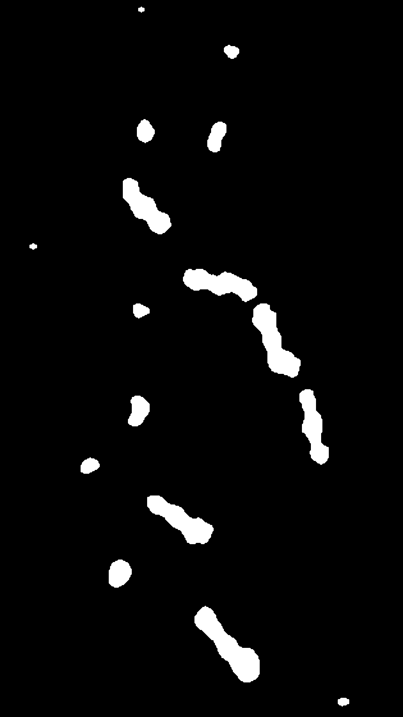
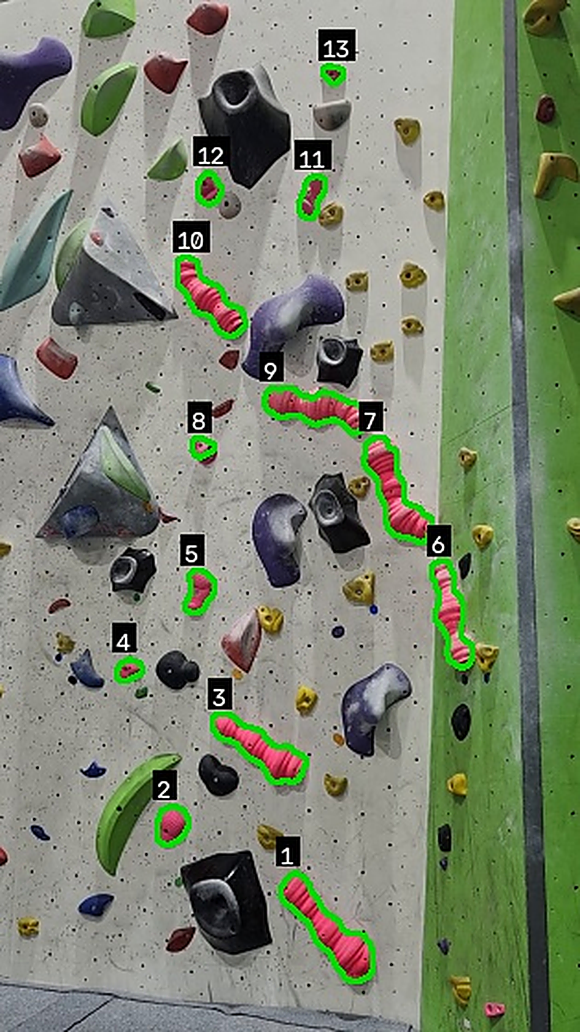
How hold detection works
APPROACH
Still frame, taken before the climber steps in
Convert to HSV, which separates colour from brightness so shadows matter less
Colour mask: keep pixels inside the hold’s colour range, set by hand or by tapping a hold (white = match)
Clean up: remove specks and fill small gaps
Find outlines of each white blob
Size filter: drop blobs too small or too big to be holds, such as specks and wall panels
Mask (steps 3–4)
Result (steps 5–6)
8
Notes:
This is the hold detection pipeline on a real photo of the pink route at Suas. I take one still frame before the climber steps in, because their body would block holds later. I convert it from BGR to HSV, which separates the colour (hue) from how bright it is, so a hold in shadow still has roughly the same hue. Then I keep only pixels inside the hold’s colour range, which can be tuned by hand or set by tapping one hold. That gives the mask on the left: white is pink, black is everything else. You can see the small specks: a morphology open and close removes specks and fills gaps. Then I find the outline of each white blob and filter by size, so the specks are too small and wall panels are too big. What’s left is the result on the right: all 13 pink holds found, with no false outlines.

Slide 9
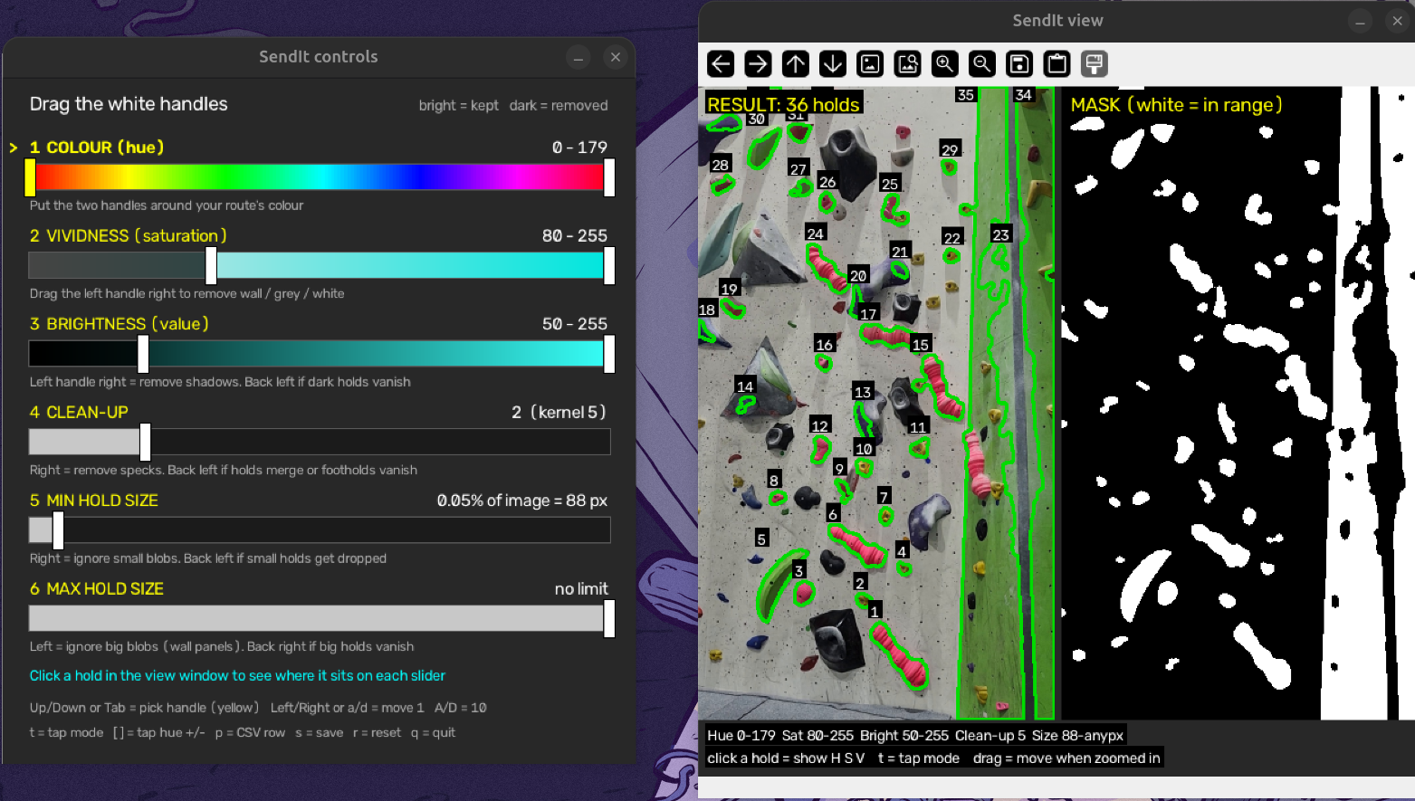
My hold detection tuning tool
WORK TO DATE
Six sliders
Colour, vividness, brightness, clean-up, min and max hold size
Live view
Result and mask side by side, updated as you drag
Tap mode
Click one hold to set the colour range automatically
Results logging
Saves images and prints a CSV row for each test
Shown before tuning: 36 outlines, including wall panels. After tuning: 13 of 13 pink holds.
9
Notes:
To tune and test the method I built this tool in Python. The controls window has a slider for each setting in the pipeline: the colour range, vividness, brightness, clean-up and minimum and maximum hold size. The view window shows the result and the mask side by side and updates live. Here it’s on the starting settings, where the colour range covers everything, so it finds 36 outlines including whole wall panels. Narrowing the colour to pink and raising the vividness gets it to all 13 pink holds with no false outlines, which is what you saw on the last slide. Tap mode lets you click one hold and builds the range for you, and for every test I save the images and record a row in my results spreadsheet, which is where the numbers on the next slides come from.

Slide 10
Hold detection prototype: first results
WORK TO DATE
Hand-tuned settings
Tap-to-sample (one tap on a hold)
11 wall photos, 10 colours, 160 holds
7 photos redone so far
81%
76%
92%
79%
of holds found
of outlines were real holds
found (89% hand-tuned)
real holds (74% hand-tuned)
✓ Test footage filmed and labelled at Suas
✓ Python tuning tool with tap-to-sample
✓ GitHub repo and task board (65 tasks)
Development set only; final evaluation uses new photos
10
Notes:
So far I’ve filmed test footage at Suas, labelled it, and built the hold detection prototype in Python with a tuning tool. On 11 photos covering 10 hold colours, hand-tuned settings found 81% of the 160 holds, and 76% of the outlines it drew were real holds. Then I added tap-to-sample: you tap one hold and it builds the colour range from that. On the 7 photos I’ve redone so far it found 92% of holds versus 89% hand-tuned, with fewer false outlines, from a single tap. These are development numbers, since I tuned on these photos; the final evaluation in March will use fresh photos.

Slide 11
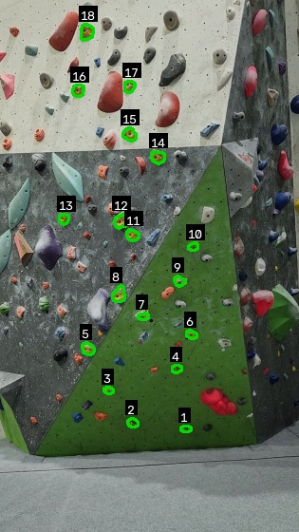
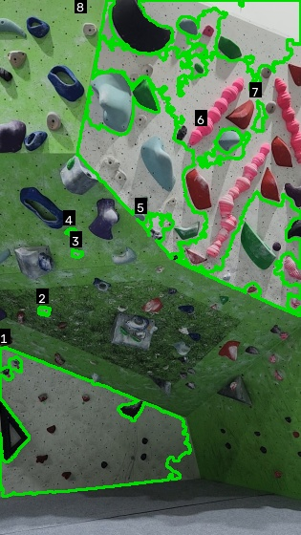
What works, and what doesn’t
WORK TO DATE
Works
Improved
Fails
Lime: 7 of 7 holds, no false outlines, from a single tap.
Yellow: a max hold size filter removed wall panels. 18 of 18 holds; real outlines up from 78% to 100%.
White: 3 of 15 holds. White has no colour to match against a white wall, so wall panels get picked up.
Key finding: most false outlines are real holds from other climbs of the same colour. Colour alone can’t pick out one route, which is why the user taps the top hold.
11
Notes:
Three examples. Lime works perfectly: one tap and every hold is found. Yellow shows an improvement I made: the wall panels were being picked up as huge “holds”, so I added a maximum size filter. Panels are about 4% of the image while the biggest hold is under 1%, and that took precision on this photo from 78% to 100%. White is the failure case: a white hold on a white wall has no colour to separate it, and dark blue and holds in shadow have similar problems. The biggest lesson is that most false positives are correct-colour holds from other routes, so colour can’t identify the route on its own. That justifies the design where the user taps the top hold.

Slide 12
Anticipated challenges
CHALLENGES
Challenge | How I’ll handle it
White, dark or shadowed holds are hard to find by colour | Tap-to-sample; user confirms holds; trained detector as future work
Same-colour holds from other climbs | User taps the top hold and marks the route area
Pose tracking lost (facing the wall, overhangs, other people) | Smooth landmarks, allow missed frames, track only the main climber
Speed on a phone | Find holds once on a still frame; downscale; skip frames for pose
Learning Flutter and Dart | Python prototype first; Dart basics now; port over Christmas
Phone storage filling up with videos | Record at 720p, trim to the attempt, auto-delete old videos
Filming people (privacy, GDPR) | Gym permission; ethics approval first; videos stay on the phone
12
Notes:
The main technical risks are hold colours that don’t stand out, holds from other routes, and pose tracking failing when the climber faces the wall or is on an overhang. Each has a mitigation built into the design, and I’ll test pose tracking on my real clips first. Because videos are stored on the phone, a regular climber could fill their storage over a few months, so videos are recorded at 720p, trimmed to just the attempt, and old ones can be cleared automatically; the climb records themselves are only a few kilobytes. The biggest practical risk is that I’m new to Flutter and Dart, so I’m working out the logic in Python first, where I’m faster, and doing the Dart basics alongside. And since the app films people, I have permission from the gym, ethics approval comes before any user testing, and videos never leave the phone unless the user shares them.

Slide 13
Plan for the rest of the year
PLAN
Oct · now
Nov–Dec
Christmas
Jan–Feb
Feb–Mar
Mar–Apr
Hold detection prototype, test footage, slides, ethics
Pose prototype on clips, start/top/fall rules, wireframes, database design
Flutter app: camera, local logbook, hold detection in Dart, route overlay
Live pose tracking, auto start/stop, topped/fell, gym field test
Logbook, final accuracy evaluation, user testing
Bug fixing, polish, secondary features if time
Product 20 Apr, report 26 Apr
Interim report 23 Dec
Draft report 19 Mar
Tracked on a GitHub project board with monthly milestones. The hardest phase (live tracking) is early in semester 2, leaving time to fix problems.
13
Notes:
Here’s the plan. For the rest of this semester I’ll build the pose prototype in Python: running pose detection on my clips and writing the start, top and fall rules, plus wireframes and the database design, then the interim report. Over Christmas I start the real Flutter app and port hold detection to Dart. Early semester 2 is the hardest part, live pose tracking and auto-recording, so I’ve put it early to leave time for problems. Then the logbook, the final evaluation on fresh footage and user testing before the draft report. Secondary features only come in if the core is done. Everything is tracked on a GitHub board with a milestone per phase.

Slide 14
Questions?
SendIt: spots the route, watches the climb, logs the outcome.
Kevin Monahan · Supervisor: Fazilat Hojaji
Notes:
To sum up: SendIt finds the route from the video, watches the attempt and logs the result, so climbers don’t have to. The hold detection prototype already works on most colours, and the next step is the pose prototype in November. Thanks, happy to take questions.

